Slide 1
ElevateX
The Future of Crowd - Aware Elevators
Domain Name: IoT-Based Embedded Systems for Smart Automation
Group no : 2
TEAM MEMBERS
Shobhit Poddar:
Ujjawal Singh:
Raushan Kumar:
Suryansh Subham:
Ashutosh Kumar:

Slide 2
Introduction :
The Smart Lift System is an IoT-based elevator prototype designed to optimize floor navigation based on real-time crowd detection. The system integrates embedded hardware (ESP32, reed switches, LEDs, and DC gear motor) with computer vision software running on laptops (using Python and OpenCV). Each floor is equipped with a laptop camera that detects the number of people waiting. This data is wirelessly sent to the ESP32, which then determines the most crowded floor and automatically moves the lift to that location. Neodymium magnets and reed switches are used for precise floor detection, while LEDs provide visual indication of the lift's current position.

Slide 3
Problem Statement :
Traditional elevator systems follow fixed or sequential logic.
They do not prioritize based on real-time crowd demand or urgency.
Passengers experience long waiting times during peak hours.
Inefficient routing leads to increased energy consumption.
Existing systems lack intelligent control and crowd-awareness.
There's no automatic floor prioritization based on people waiting.
Limited remote monitoring capabilities in conventional systems.
Absence of adaptability in case of emergency or dynamic needs.

Slide 4
Objective:
Design an IoT-based smart lift system that uses real-time crowd data for floor prioritization.
Integrate computer vision (OpenCV) on each floor to count waiting passengers.
Wirelessly transmit crowd data from laptops to ESP32 using Wi-Fi.
Automatically move the lift to the floor with the highest crowd count.
Use reed switches and magnets for accurate floor detection.
Indicate the current floor using LEDs for visual feedback.
Return the lift to a demand-based floor after serving passengers.
Reduce passenger waiting time and improve energy efficiency.
Enable remote monitoring and adaptive response to changing conditions.

Slide 5
Block Diagram :
The system design of the IoT-based smart lift system focuses on integrating real-time sensing, wireless communication, and automated lift control using a modular and scalable approach. The design ensures smooth interaction between hardware, software, and IoT infrastructure.

Slide 6
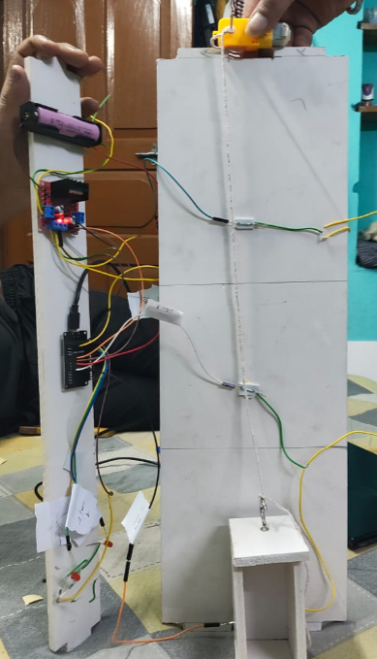
Circuit Diagram :
The Smart Lift System circuit integrates the ESP32 microcontroller with key components like reed switches for floor detection, LEDs for floor indication, an L298N motor driver, and a DC gear motor for movement. Neodymium magnets on the lift trigger reed switches placed at each floor, allowing the ESP32 to detect its position. The motor driver, powered by a 12V source, controls the lift's direction based on commands from the ESP32. LEDs indicate the current floor status, while laptops send real-time crowd data wirelessly to the ESP32.

Slide 7
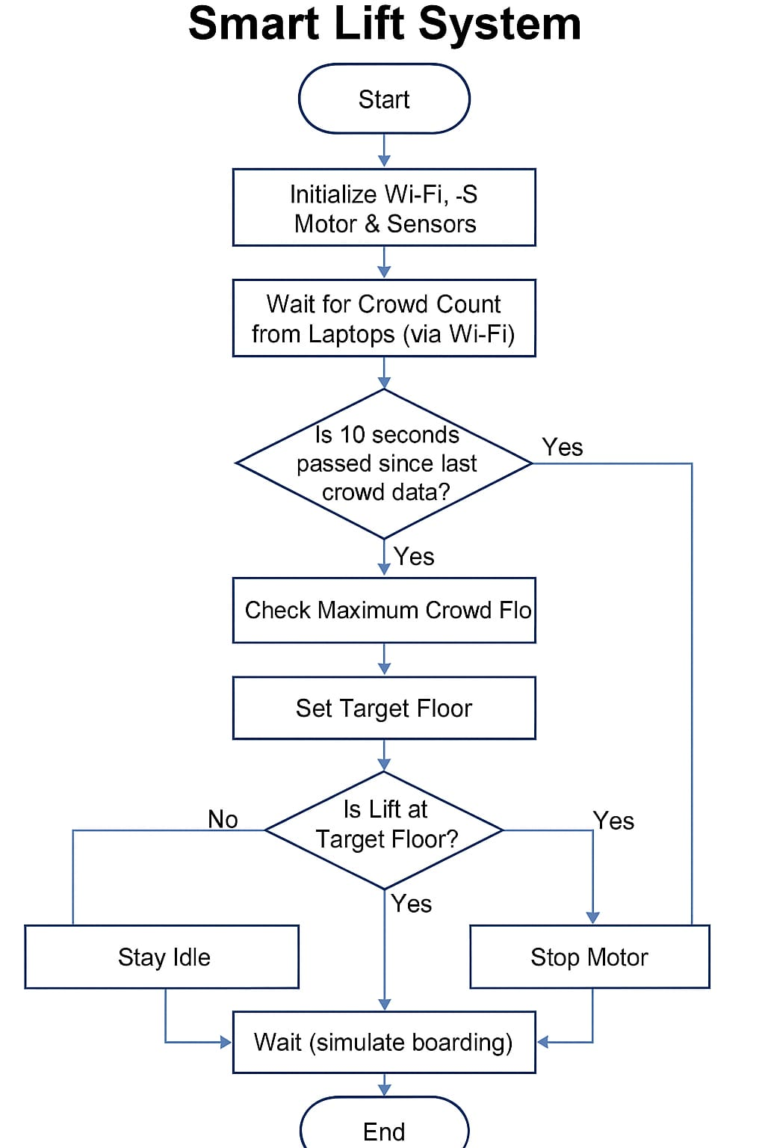
Flowchart :
This flowchart represents the working logic of the Smart Lift System in a simplified manner:
Start: The system begins operation.
Initialize: Wi-Fi, motor driver, and sensors (reed switches, LEDs) are set up.
Wait for Crowd Count: Each laptop sends the number of waiting people via Wi-Fi.
Check if 10 Seconds Passed: It checks whether enough time has passed since the last data was received.
Identify Maximum Crowd: Among all floors, it identifies the floor with the highest crowd count.
Set Target Floor: That most crowded floor is selected as the destination.
Check Lift Position:
If the lift is already at the target floor → Stop the motor and simulate boarding.
If not → The system stays idle or moves the lift accordingly.
Wait (simulate boarding): The lift waits to simulate the boarding process.
End: One operation cycle ends.

Slide 8
Software Implementation (Tinkercad) :
An ESP32 equivalent represented by an Arduino UNO (as ESP32 is not directly available in Tinkercad).
Reed switches simulated using push buttons to represent floor detection.
LEDs representing the lift’s position on each floor.
Motor functionality simulated using LEDs or a servo motor to visualize movement.
Code uploaded to control motor direction, stop at the correct floor, and light up LEDs accordingly.

Slide 9
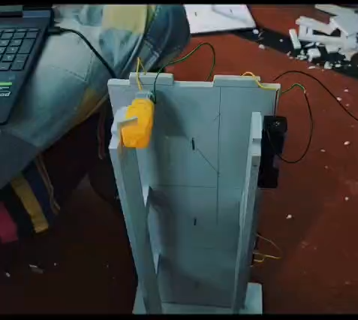
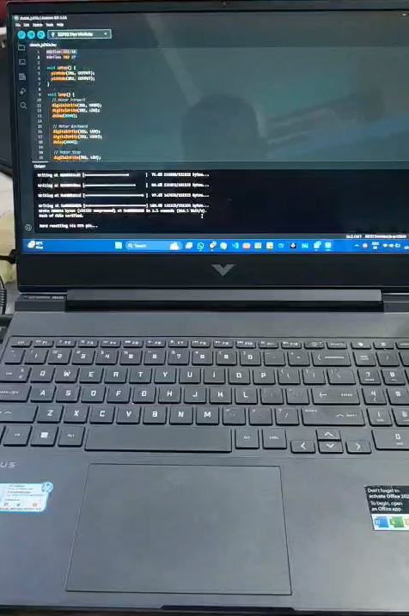
Demonstration Video :

Slide 10
Applications of Smart Lift System :
Space-Efficient Smart Buildings: Automatically dispatches lifts to the most crowded floor, improving traffic flow in commercial and
residential buildings.
Hospitals & Emergency Facilities: Prioritizes floors with high crowd demand, crucial in medical emergencies for faster response.
Office Complexes & Malls: Reduces waiting time during peak hours, enhancing visitor experience and operational efficiency.
Accessible Lift Assistance: Beneficial for elderly or differently-abled people by reducing time spent waiting for elevators.
Educational Institutions: Helps manage large crowds between class transitions by dynamically allocating lift services.
Industrial Automation: Can be adapted to control lift-based material handling systems based on demand.

Slide 11
Past reports :
We began the project by identifying inefficiencies in traditional lift systems and proposed a smart solution using IoT and embedded systems. Crowd detection was achieved using Python and OpenCV on three laptops, each representing a floor, which sent real-time data to the ESP32 via Wi-Fi. Simultaneously, we built the hardware circuit using an ESP32, L298N motor driver, DC gear motor, reed switches, magnets, and LEDs for floor detection. The Arduino code was developed and tested to control motor direction and LED indicators based on the most crowded floor. After verifying individual modules, we successfully integrated both hardware and software into a working prototype.
Why These Projects Are Relevant to Your Lift System?
Common Features: Like other smart systems, our project includes real-time monitoring, automation, remote access, and safety alerts.
Overlap: It uses ESP32, sensor integration, and a web interface—similar to many IoT projects.
Unique Point: Our system stands out by combining real-time crowd detection, floor prioritization, limit-switch homing, and precise motor control, which is rarely found together in previous works.

Slide 12
Future Scope :
AI-based Decision Making: Integrate machine learning to predict crowd patterns and optimize lift scheduling automatically.
Advanced Camera Vision: Use facial recognition or advanced object detection for better accuracy in people counting and access control.
Cloud Integration: Store usage data in the cloud for analytics, remote diagnostics, and maintenance tracking.
Access Control Systems: Add RFID, fingerprint, or facial ID to allow only authorized users to access certain floors.
Voice & Gesture Control: Enable hands-free lift operation through voice assistants or gesture recognition for improved accessibility.

Slide 13
Conclusion :
The Smart Lift System successfully integrates IoT, embedded systems, and computer vision to create an intelligent elevator prototype.
Real-time crowd detection ensures that the lift prioritizes the floor with the highest demand, reducing waiting time.
The ESP32 microcontroller efficiently controls the lift movement based on input from laptops and reed switches.
The system proves to be scalable, energy-efficient, and adaptable for future smart infrastructure needs.
This project showcases the power of automation in solving real-world problems using affordable hardware and open-source software.

Slide 14
Result :
Successfully implemented a working prototype of a Smart Lift System using ESP32, DC gear motor, reed switches, and laptop cameras.
Accurate real-time crowd count data was transmitted via Wi-Fi from laptops to ESP32.
Neodymium magnets and reed switches reliably detected the lift’s position on each floor.
LEDs provided clear indication of the lift’s current location.
The lift consistently moved toward the floor with the highest crowd and stopped precisely at the desired floor.
Logic integration between software and hardware worked as intended, demonstrating intelligent lift behavior.

Slide 15
References :
ESP32 Dev Board – Used for Wi-Fi connectivity, web server hosting, and main control logic.
ESP32 Documentation https://docs.espressif.com/
(Official reference for understanding GPIOs, web server setup, and communication)
Arduino Official Reference https://www.arduino.cc/reference/en/ (For coding standards, digital I/O, PWM control, and motor interfacing)
IoT Elevator Projects – Referenced from IEEE, GitHub, MDPI, and Atlantis Press (Helped in benchmarking features and refining our solution)
Open-source tutorials and forums – (Inspiration and debugging support from platforms like StackOverflow, Instructables, and GitHub projects related to smart lifts and IoT integration)

